Slide 1
Congestion Trees
How information moves in
load heavy networks.

Slide 2
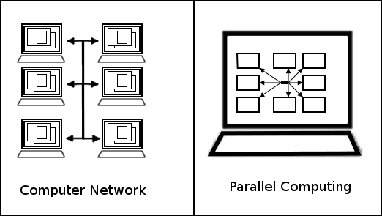
What is a Network
Notes:
There are two main types of networks that we consider in computer Engineering: Networks of computers and networks of chips
the prime example of the former is the internet: practically every computer in the world linked through their ethernet cables and wifi cards
or intra-computer communication we have different requirements
For the internet, it’s often OK if information is lost.
not all info is important i.e. if your boston.com fails.
Parallel computing, however, cannot lose information.
i.e. if a thread is running on another core, and the interrupt unlock is not received, the program will block
can be multicore / process communication
Trees can grow faster

Slide 3
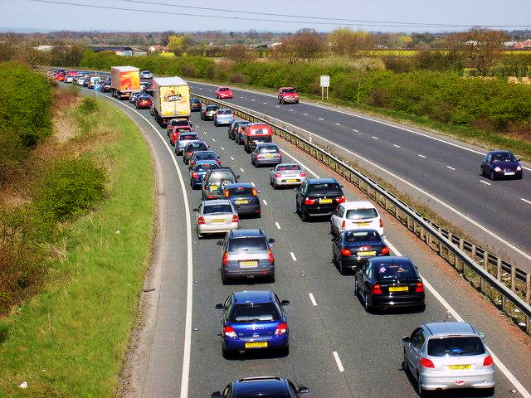
What is Congestion
Networks operate at switches
Congestion is when too much information passes through the same nodes
Image Copyright Sam Kelly. This work is licensed under the Creative Commons Attribution-Share Alike 2.0 Generic Licence.
Notes:
The problem with ne

Slide 4
Congestion Trees
Source 1
Source 1
Node
Node
Destination 1
Destination 1
Node
Node
Node
Source 2
Node
Node
Node
Destination 2
Node
Destination 2
Node
Node
Node
Source 3
Node
Node
Destination 3
Destination 3
High Traffic
Notes:
This is a problem because even though only source 1 is high traffic, it affects all the modules

Slide 5
The Problem:
How do we maximize throughput for a given network ensuring:
Minimal packet loss
“Fair” queueing
Notes:
High - traffic nodes will always happen. How can we avoid full-scale tree like

Slide 6
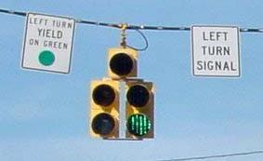
Types of Congestion
Head of line Congestion
One resource is blocked and is forcing resources to queue behind it
Waiting to turn left can block cars going straight.
By FHWA, NCDOT [Public domain], via Wikimedia Commons
Notes:
Head of line switching is bad when queues are built at input ports.

Slide 7
Relief Algorithm
Head of line Congestion
RECN: If a line is congested, give it its own queue
A left hand turn lane
By FHWA, NCDOT [Public domain], via Wikimedia Commons
Notes:
One way is send it to the back of the queue if it bounces
-Does not maintain order
stands for (Regional Explicit Congestion Notification)
how it works
Detects Congestion at port of “egress” also known as output port
alerts the next switch to build a separate input queue to clear the backup

Slide 8
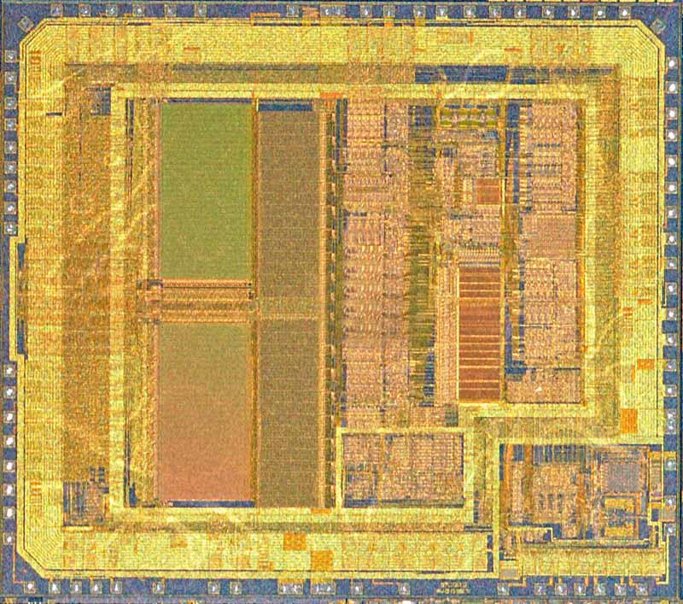
Types of Congestion
Chip Congestion
TCGR: Timing-Constrained Congestion-Driven Global Routing
Build the chip around the problem
System of Highways and Cities
Image Copyright Ross Elliott. This work is licensed under the Creative Commons Attribution-Share Alike 2.0 Generic Licence.
Notes:
Timing Constrained Congestion Driven Global Routing

Slide 9
Works Cited
García, P. J., J. Flich, Duato, I. Johnson, F. J. Quiles, and F. Naven. "Dynamic Evolution of Congestion Trees: Analysis and Impact on Switch Architecture." LNCS 3793 (2005): 266-85. Web.
Jiang, Libin, and Jean Warland. "A Distributed CSMA Algorithm for Throughput and Utility Maximization in Wireless Networks." IEEE/ACM TRANSACTIONS ON NETWORKING 18.3 (2009): 960-72. Web.
Yan, J.-T. "Dynamic Tree Reconstruction with Application to Timing-constrained Congestion-driven Global Routing." IEE Proceedings - Computers and Digital Techniques 153.2 (2006): 117-29. IEEE. Web. 1 Dec. 2014.

