Slide 1
Intel Core I7 Pipeline
Wei-Tse Sun

Slide 2
Core I7 Haswell
Launched last year
quad-core processor

Slide 3
Pipeline
cycle, latency
how many instructions we can execute at the same time?
branch prediction
cache-handle cache misses

Slide 4
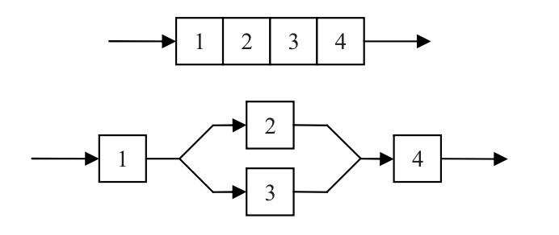
Single Thread Pipeline
Section working-sharing Step 2 and 3 are independent and can be performed in parallel.

Slide 5
For-loop parallel execution
Loop work-sharing The loop can be repeat if iterations have no dependencies between each other.

Slide 6
core i7
Branch Prediction
Improves performance and saves wasted work
Handle cache misses in parallel to hide latency
Deeper buffers -more instruction parallelism -more resource when running a single thread
Power down execution units when not in use
More load/store bandwidth -better cache line split latency
Icache Tag
TLB
Cache Tag
Icache Data
Cache Data
Decode
Allocation
Out-of-Order Execution
0
1
2
3
4
5
6
7

Slide 7
Interconnect
Improved load balancing to System Agent
More efficiently shares resources, low latency
Better scheduling
Lower power, better efficiency
System Agent
Core | LLC
Core | LLC
Core | LLC
Core | LLC

Slide 8
Cache hierarchy
Pipelines handle data & non-data accesses independently.
load balancing to system agent.
deeper pending queues, better scheduling.
large eDRAM Cache -high throughput and low latency

Slide 9
Reference
HASWELL: THE FOURTH-GENERATION INTEL CORE PROCESSOR- published by the IEEE Computer Society 2014
4th Generation Intel Core Processor, codenamed Haswell- Per Hammarlund , August 2013
Performance of Parallel Algorithms Using OpenMP- Roman Mego and Tomas Fryza, IEEE 2013
Improving Energy Efficiency through Parallelisation and Vectorisation on Intel core i5 and i7 Processor- Juan M. Cebrian, Jan Christian Meyer and Lasse Natvig, IEEE 2013

Slide 10
Thank you

