Slide 1
Power Distribution and Redistribution of Workloads in Cloud Computing Facilities
Cornell Wilson

Slide 2
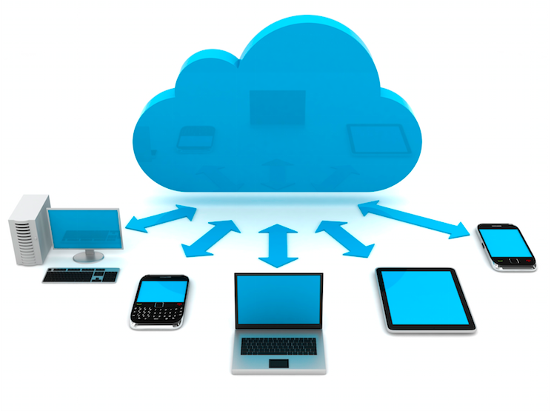
What is cloud computing?

Slide 3
2011 NIST Definition
Five Essential Characteristics:
On-demand self-service
Broad network access
Resource pooling
Rapid elasticity
Measured service

Slide 4
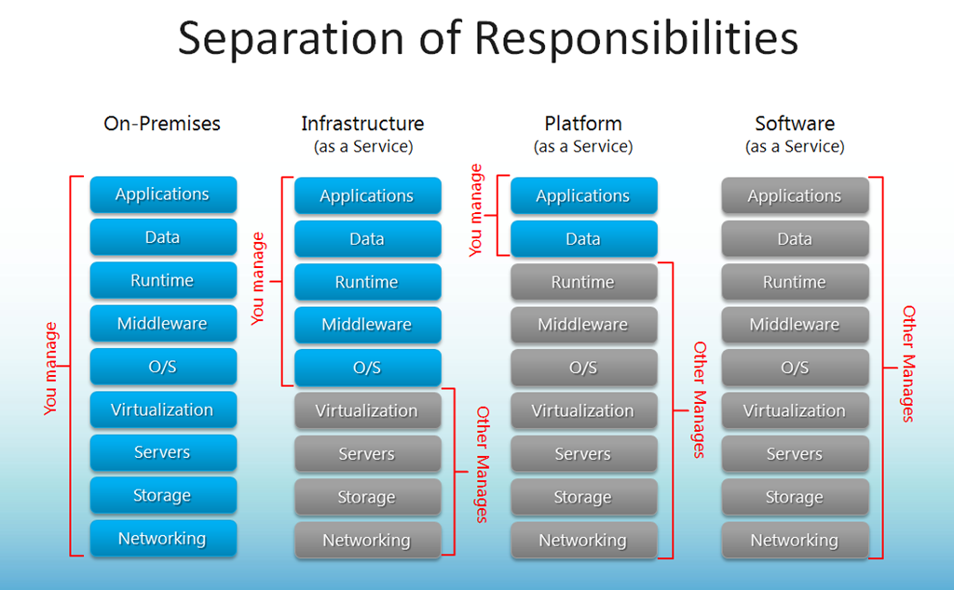
2011 NIST Definition
Service Models:
Software as a Service (SaaS)
Platform as a Service (PaaS)
Infrastructure as a Service (IaaS)

Slide 5
2011 NIST Definition
Deployment Models:
Private
Community
Public
Hybrid

Slide 6
Why Cloud Computing?
Lower initial cost, faster implementation, lower overhead, ease of access, superior service, etc.

Slide 7
How does it work?
Virtualization
Load Balancing

Slide 8
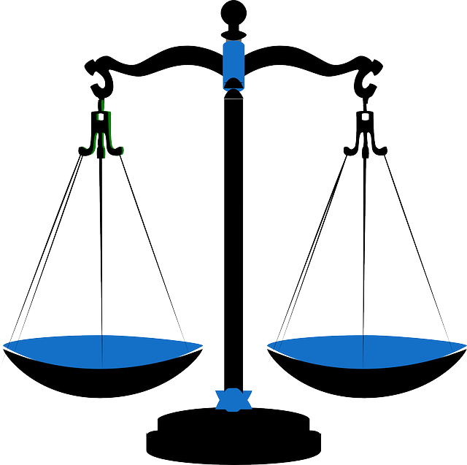
Load Balancing Techniques
VectorDot, CARTON, Event-Driven, CLBVM, LBVS, Biased Random Sampling, Active Clustering, COMPARE AND BALANCE, Join-Idle-Queue, Honeybee Foraging Behavior, (OLB + LBMM), and more…

Slide 9
Load Balancing Metrics
Performance
Response Time
Scalability
Overhead
Throughput
Resource Utilization
Fault Tolerance
Migration Time
Energy Consumption
Carbon Emission

Slide 10
Some Examples
CARTON
Unifies Load Balancing (LB) and Distributed Rate Limiting (DRL)
LB equally distributes jobs to different nodes
DRL assures resources are allocated so that performance levels at all nodes are equal
Low overhead, easy to implement

Slide 11
Some Examples
Biased Random Sampling
Randomly samples the system domain to achieve self-organization
Balances the load across all nodes
Performs well with system of many similar nodes
Degrades as node diversity increases

Slide 12
Some Examples
Honeybee Foraging Behavior
Inspired by bees in nature
Global load balancing is achieved through local actions of each node
Performs well with a diverse system of nodes and request types
Throughput does not scale with system size

Slide 13
T15 = CARTON
T10 = Biased Random Sampling
T9 = Honeybee Foraging Behavior

Slide 14
Power Consumption and Energy Efficiency
Process efficiency correlates with energy efficiency
No algorithm explicitly addresses this issue
Cloud holds promise for green computing
Active area of research

Slide 15
Conclusion
Cloud Computing
What?
Why?
How?
Load Balancing
Importance
Different methods
Metrics
Power consumption
Thank you!

Slide 16
Bibliography
Al-Rayis, E., & Kurdi, H. (2013, November 20-22). Performance analysis of load balancing architectures in cloud computing. Paper presented at the European Modelling Symposium, Manchester, England. doi: 10.1109/EMS.2013.10
Guo, L., Zheng, F., Hu, Y., Xiao L., & Liu, L. (2013) Analysis and research of cloud computing data center. Applied Mechanics and Materials, 427-429, 2184-2187.
Hamdaqa, M., & Tahvildari, L. (2012). Cloud computing uncovered: A research landscape. Advances in Computers, 86, 41-84.
Kansal, N. J., & Chana, I. (2012) Cloud load balancing techniques: A step towards green computing. International Journal of Computer Science Issues, 9(1), 238-246.
Kansal, N.J. , & Chana, I. (2012) Existing load balancing techniques in cloud computing: A systematic review. Journal of Information Systems and Communication, 3(1), 87-91.
Kaur, R., & Luthra, P. (2014, March 21). Load balancing in cloud computing. Paper presented at the International Conference on Recent Trends in Information, Telecommunication and Computing, Chandigarh, India. doi: 02.ITC.2014.5.92
National Institute of Standards and Technology. (2011). The NIST Definition of Cloud Computing (NIST Special Publication 800-145). Gaithersburg, MD: U.S. Department of Commerce.

Slide 17
Image Sources
http://thoughtsoncloud.com/wp-content/uploads/2014/03/What-is-cloud-computing.png
http://mschnlnine.vo.llnwd.net/d1/inetpub/kevinremde/Images/679669067395_DBE9/image_3.png
http://cdn.xenlife.com.au/wp-content/uploads/nuvem.jpg
http://pixabay.com/static/uploads/photo/2014/04/03/10/06/scales-309810_640.png
http://www.ijcsi.org/papers/IJCSI-9-1-1-238-246.pdf
http://www.worldwatch.org/files/images/pubs/mag/pc-pollution.gif
http://images.dailytech.com/nimage/31455_large_CC.jpg

