Slide 1
Virtual Machine Usage in Cloud Computing for Amazon
EE126: Computer Engineering
Connor Cunningham
Tufts University
12/1/14
Notes:
Keywords:
COMPUTE RESOURCES

Slide 2
Outline
Introduction/Overview
Methods
Challenges/Future Trends
Conclusion

Slide 3
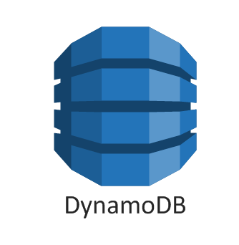
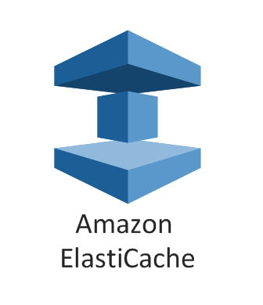
Introduction
Notes:
Amazon Web Services, a subsidiary of Amazon.com, Inc. offers a number of remote computing products
Products offer services in compute & networking, storage, databases, and application management
These cloud-based products utilize virtual machines in their implementation

Slide 4
What is Cloud Computing?
On-demand delivery of IT resources and applications via the Internet with pay-as-you-go pricing [1]
Notes:
"Cloud Computing", by definition, refers to the on-demand delivery of IT resources and applications via the Internet with pay-as-you-go pricing. [2]
Computational resources are shared
Idea evolved from time-sharing on large mainframe computers in the 1950s
Cloud computing utilizes a Service-oriented Architecture, grid computing (distributed, parallel with virtual computer API), and virtualization
Virtualization achieved through Virtual Machines, so what are they?

Slide 5
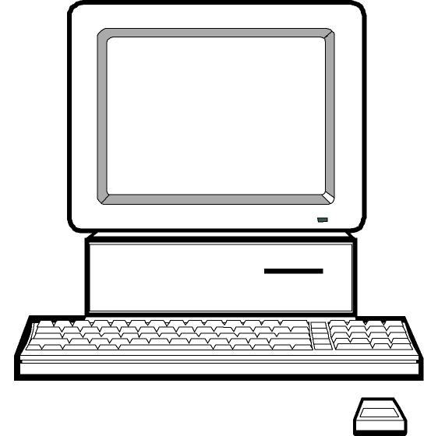
What are Virtual Machines (VMs)?
An operating system or application environment that is installed on software which imitates dedicated hardware [2]
Notes:
- An operating system or application environment that is installed on software which imitates dedicated hardware ^{[2]}
Virtual machine manager (hypervisor) emulates the operating system/app environment’s hardware (vs. simulates w/out firmware)
Powerful because user maintains experience of OS or environment, but hardware usage is optimized through flexible allocation of resources
VIRTUALIZATION

Slide 6
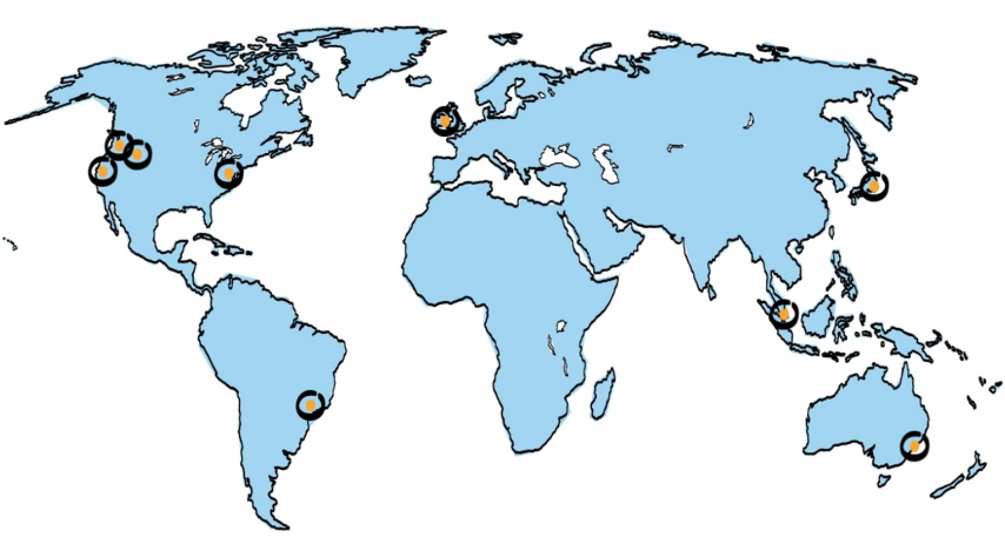
Amazon’s Cloud
Notes:
Amazon has datacenters throughout world with necessary hardware for virtual machines (run OS, servers, databases)
By centralizing components (memory, processing, storage) and employing virtualization, they are able to offer flexible remote computing services

Slide 7
Outline
Introduction/Overview
Methods
Challenges/Future Trends
Conclusion
Notes:
- Let’s take a look at one of most popular services, Elastic Compute Cloud

Slide 8
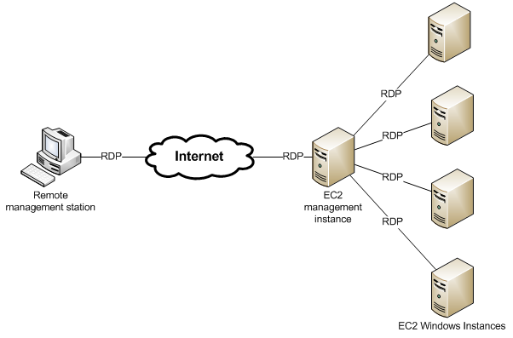
Elastic Compute Cloud (EC2)
Web service that provides resizable compute capacity in the cloud [1]
Notes:
Virtual computing environment that provides a web services API for launching and managing virtual machine instances
CPU capacity is defined in terms of an abstract Amazon EC2 Compute Unit
Nodes connected by gigabit ethernet, Amazon also provides Elastic Block Storage to manage memory between instances

Slide 9
AWS vs. Google Cloud Platform
Persistent disks across VMs
High network throughput
Highly efficient APIs
Live VM migration for maintenance
Less international distribution [3]
EBS attached to one VM
Lower network throughput
Less efficient APIs
Forced EC2 instance reboots
Widespread geographical distribution [3]
Notes:
Qualitative comparison of differences between AWS and Google’s Cloud solution
300Mbps vs. 25Mbps
Instance start/restart time

Slide 10
Outline
Introduction/Overview
Methods
Challenges/Future Trends
Conclusion

Slide 11
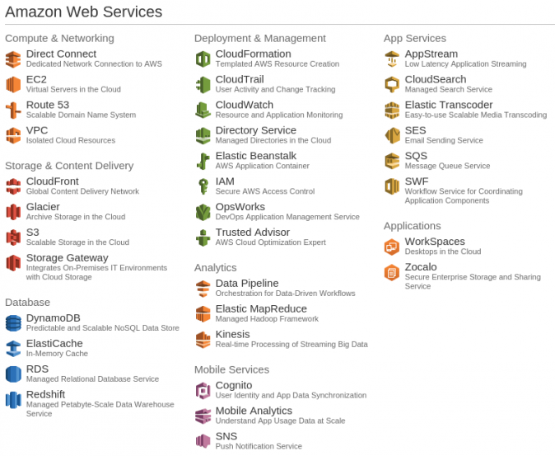
Optimization
Elastic Load Balancing (ELB)
Integrated networking
Instance storage
Migration
Dynamic resource allocation [4]
Notes:
Elastic Load Balancing automatically distributes incoming application traffic across multiple Amazon EC2 instances
Networking essential to connect instances and VM interoperability
Research developed local node utility function w/ resources governed by a global VM controller

Slide 12
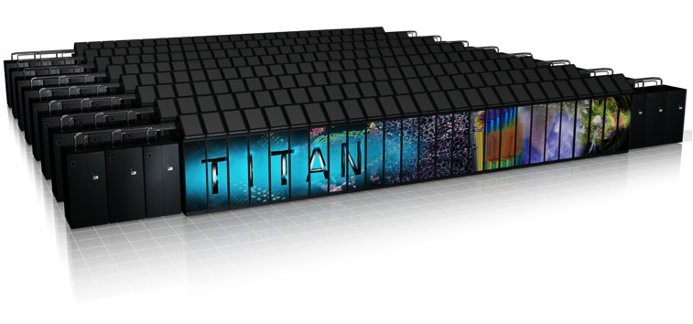
High Performance Computing (HPC)
HPC applications executed in cloud environments [4]
EC2 vs.10K node supercomputer
Revealed weaknesses in cloud architecture
Notes:
Focus on utilizing cloud resources for HPC applications such as modeling subatomic quark interaction
10K node (1 processor per node) vs. equivalent # instances
Increased overhead due to shared nature of virtualized env.
Differences in underlying non-virtualized hardware

Slide 13
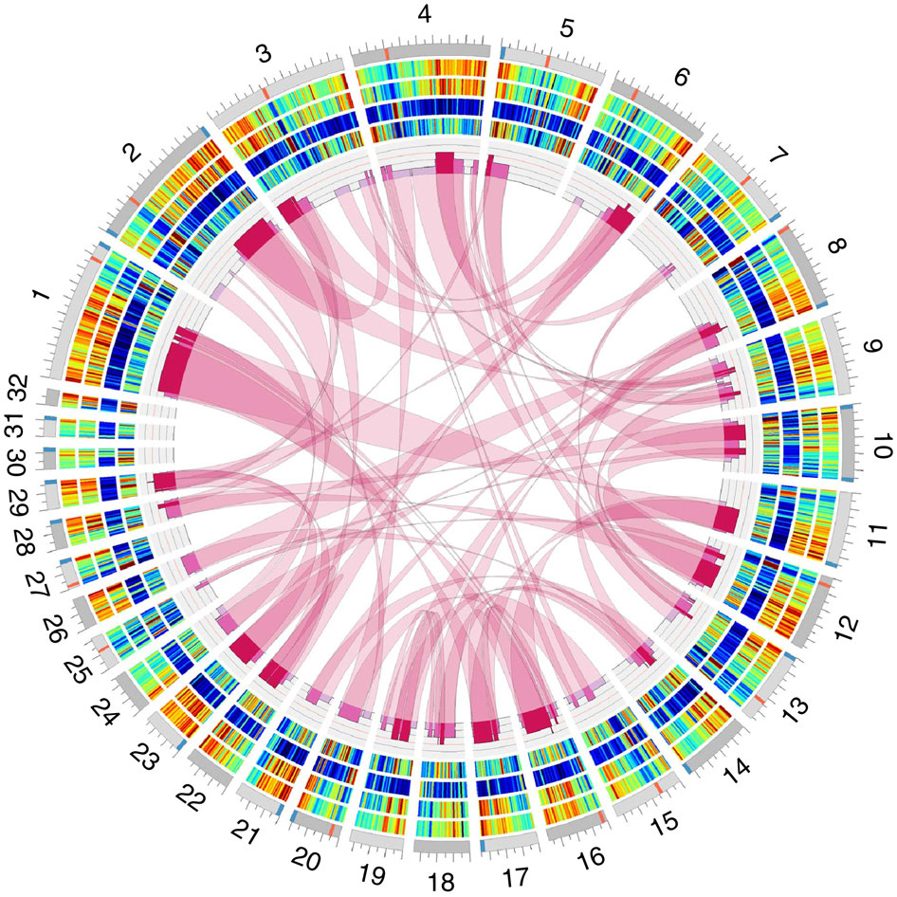
Future Trends
VMs for HPC [5]
Opportunity: Convenient deployment of scientific applications
Challenge: High overhead and non- trivial implementation
Large-Scale Data Analytics [6]
Opportunity: Large scale ad hoc analytics with on-demand resources
Challenge: Lack of framework to adapt analysis to cloud
Notes:
Specialized hardware components that are difficult to emulate, such as ASICs for node communication
Developers creating frameworks to execute common analysis tools such as R-scripts

Slide 14
Outline
Introduction/Overview
Methods
Challenges/Future Trends
Conclusion

Slide 15
Conclusion
Cloud Computing provides a simple way to access servers, storage, databases and a broad set of application services [1]
Market competition continues to improve capability and usability
Varied customer base introduces range new applications for cloud

Slide 16
References
[1] Unknown Author (2014, January 1). What is Cloud Computing? Retrieved November 30,
2014, from http://aws.amazon.com/what-is-cloud-computing/
[2] Kirsch, B. (2014, October 1). What is a Virtual Machine? Retrieved November 30, 2014,
from http://searchservervirtualization.techtarget.com/definition/virtual-machine
[3] Narayanam, J. (2013, December 9). Ten Features that make Google Compute Engine
(GCE) better than AWS. Retrieved December 1, 2014, from http://yourstory.com/2013/12/google-compute-engine-better -than-aws/
[4] Jackson, K.R.; Ramakrishnan, L.; Muriki, K.; Canon, S.; Cholia, S.; Shalf, J.; Wasserman, Harvey J.; Wright, N.J. (2010,
November 30) Performance Analysis of High Performance Computing Applications on the Amazon Web Services Cloud. Cloud Computing Technology and Science (CloudCom), 2010 IEEE Second International Conference on , vol., no., pp. 159,168. doi: 10.1109/CloudCom.2010.69
[5] Minarolli, D.; Freisleben, B. (2011, June 28). Utility-based resource allocation for virtual
machines in Cloud computing. Computers and Communications (ISCC), 2011 IEEE Symposium on , vol., no., pp. 410,417. doi: 10.1109/ISCC.2011.5983872
[6] Simao, J.; Singer, J.; Veiga, L., "A Comparative Look at Adaptive Memory Management in
Virtual Machines," Cloud Computing Technology and Science (CloudCom), 2013 IEEE 5th International Conference on , vol.1, no., pp.452,457, 2-5 Dec. 2013 doi: 10.1109/CloudCom.2013.66

